Slide 1



DS Capstone Spring 2023 Fantasy Baseball Projections Standup Meeting - Update
Suhas Buravalla and Carter Rogers

Slide 2
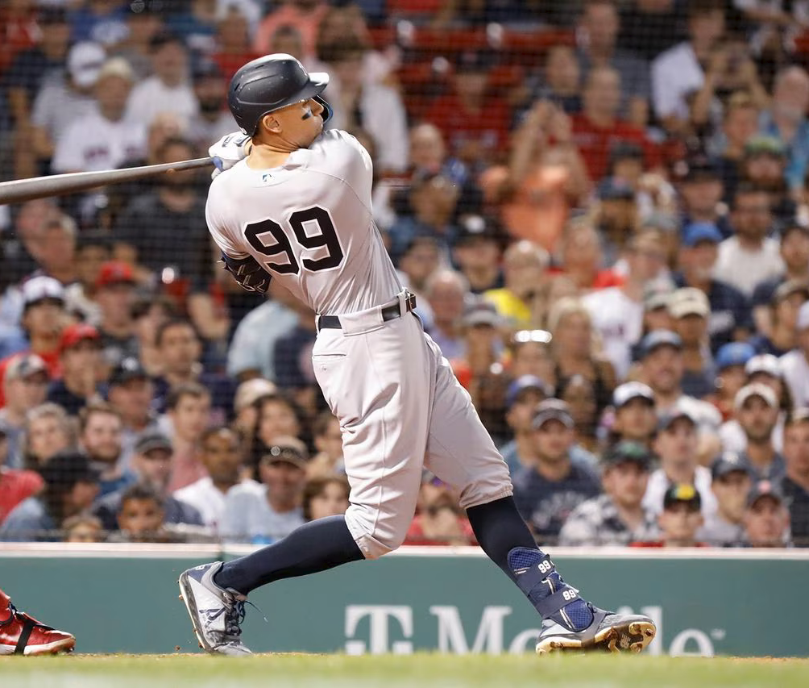
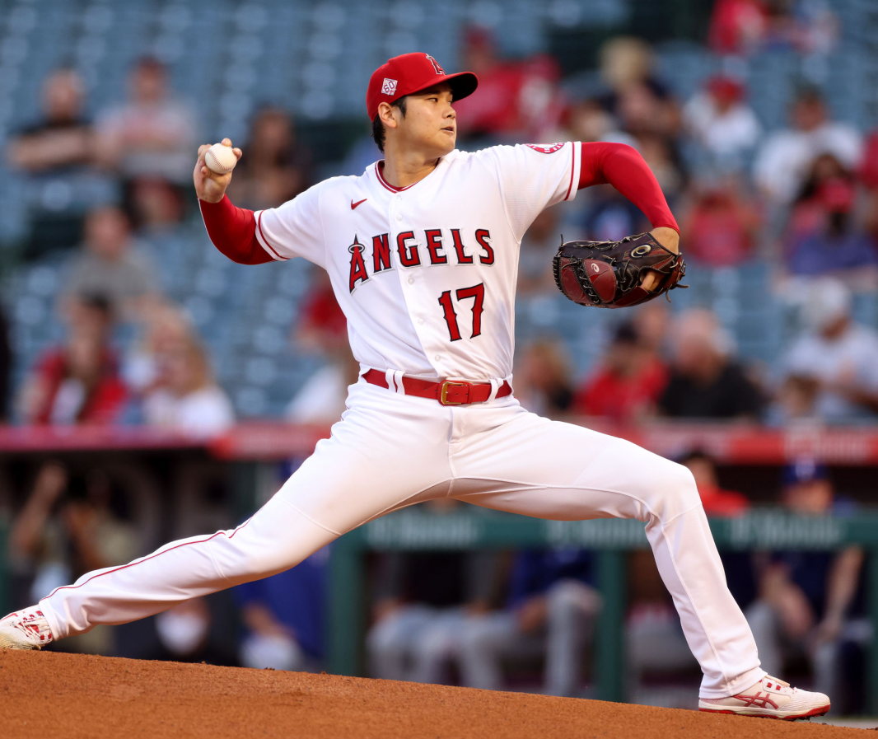
Agenda
Overview of Baseball & Fantasy Baseball
Our Data Set: Features & Targets
Preprocessing, Feature Reduction, Visualizations
Modeling: Ideas & Obstacles

Slide 3
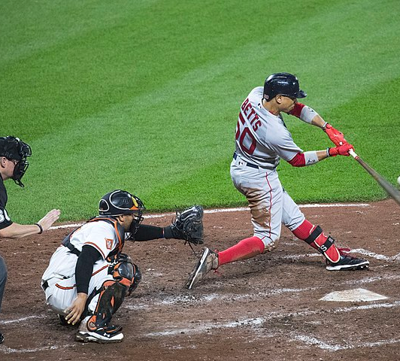
Introduction
America’s Pastime – with surprising fantasy popularity
Advanced Statistics (Moneyball)
Predicting player performance

Slide 4
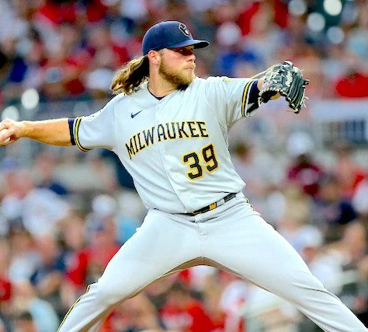
Fantasy Baseball – Roto Scoring
Traditional 5x5 Rotisserie (Roto)
For hitters: AVG, HR, R, RBI, SB
For pitchers: W, K, ERA, WHIP, SV
Projections: ATC, The Bat, Steamer, ZiPS

Slide 5
Fantasy Baseball
Subtitle

Slide 6
Chart

Slide 7
Table
 | Category 1 | Category 2 | Category 3 | Category 4
Item 1 | 4.5 | 2.3 | 1.7 | 5.0
Item 2 | 3.2 | 5.1 | 4.4 | 3.0
Item 3 | 2.1 | 1.7 | 2.5 | 2.8
Item 4 | 4.5 | 2.2 | 1.7 | 7.0

Slide 8
Timeline
Title
To start a presentation, go to the Slide Show tab, and select From Beginning.
Title
To display Presenter view, in Slide Show view, on the control bar at the bottom left select the three dots, and then Show Presenter View.
Title
During your presentation, the speaker notes are visible on your monitor, but aren't visible to the audience.
Title
The Notes pane is a box that appears below each slide. Tap it to add notes.
Title
If you don’t see the Notes pane or it is completely minimized, click Notes on the task bar across the bottom of the PowerPoint window.

Slide 9
Content
Subtitle
Subtitle
Add text, images, art, and videos.
Add transitions, animations, and motion.
Save to OneDrive, to get to your presentations from your computer, tablet, or phone.
Open the Design Ideas pane for instant slide makeovers.
When we have design ideas, we’ll show them to you right there.

Slide 10
Additional content
Subtitle
Subtitle
Subtitle
Add text, images, art, and videos.
Add transitions, animations, and motion.
Save to OneDrive, to get to your presentations from your computer, tablet, or phone.
This PowerPoint theme uses its own unique set of colors, fonts, and effects to create the overall look and feel of these slides.
PowerPoint has tons of themes to give your presentation just the right personality.
Open the Design Ideas pane for instant slide makeovers.
When we have design ideas, we’ll show them to you right there.

Slide 11
Summary
With PowerPoint, you can create presentations and share your work with others, wherever they are. Type the text you want here to get started. You can also add images, art, and videos on this template. Save to OneDrive and access your presentations from your computer, tablet, or phone.

Slide 12
Thank you
Presenter name
Email address
Website

